Slide 1





Enterprise Disk Drive Scrubbing Based on Mondrian Conformal Predictors
The 12th Symposium on Conformal and Probabilistic Prediction with Applications
Limassol, Cyprus
September 12th – 15th 2023
Rahul Vishwakarma✢
Jinha Hwang✢
Soundouss Messoudi○
Ava Hedayatipour✢
California State University Long Beach, USA ✢
HEUDIASYC - UMR CNRS 7253, Université de Technologie de Compiègne, France ◦

Slide 2

Introduction

Slide 3

Introduction > Disk Scrubbing > Approach > Experiments > Conclusions and perspectives
Introduction
Data centers are intricate ecosystems with diverse storage devices spread across multiple locations.
Managing business becomes challenging due to the complexity of each individual storage component.
Inadequate management of storage components can lead to data loss and business disruption.
Proactive monitoring of storage component health is essential, with e.g. disk drive scrubbing.
Data center illustration
Which disk to scrub ? When to scrub ?

Slide 4
Disk Scrubbing

Slide 5


Introduction > Disk Scrubbing > Approach > Experiments > Conclusions and perspectives
What is Disk Scrubbing ?
Error correction technique :
Periodically checks for inconsistencies in data, then corrects them.
Applied to disk arrays, memory, file systems, …
Targeted problems :
Data integrity issues.
Degraded system performance.
Reduced drive lifespan.
Regulatory and compliance issues.
Hard Disk Drive
Solid State Drive
Notes:
Data scrubbing is a data maintenance feature that amends data in storage pools that are incorrect or incomplete.
Data scrubbing is an error correction technique that uses a background task to periodically inspect main memory or storage for errors, then corrects detected errors using redundant data in the form of different checksums or copies of data. Data scrubbing reduces the likelihood that single correctable errors will accumulate, leading to reduced risks of uncorrectable errors.
Data Integrity Issues: Over time, data stored on disk drives can become corrupted due to various factors such as electromagnetic interference, magnetic decay, and wear and tear. Without data scrubbing, these errors may go undetected, leading to corrupted or compromised data.
Degraded System Performance: Corrupted data can lead to increased read and write errors, which can degrade the overall performance of the disk drive and the system as a whole. Slowdowns, crashes, and system instability may occur.
Reduced Drive Lifespan: Data errors and corruption can accelerate wear and tear on storage media. By identifying and correcting errors through scrubbing, the lifespan of the disk drive can be prolonged by preventing further degradation.
Regulatory and Compliance Issues: Many industries have regulatory requirements for data integrity and security. Failure to maintain data integrity through scrubbing can result in compliance violations and legal liabilities.

Slide 6
Introduction > Disk Scrubbing > Approach > Experiments > Conclusions and perspectives
Disk Scrubbing challenges
Resource Consumption
Data scrubbing is resource-intensive, consuming CPU, memory, and storage I/O.
Frequent scrubbing strains system resources, impacting system performance.
Drive Lifespan Impact
Frequent scrubbing can accelerate wear and tear on disk drives.
Counterproductive if it accelerates drive degradation instead of preventing it.
Workload Impact
Excessive scrubbing can affect the performance of concurrent workloads.
May lead to slowdowns or interruptions in critical operations.
Uncertainty in Adaptive Approaches
Existing adaptive scrubbing approaches raise questions about their effectiveness.
No room for error, as all data is crucial.
Quest for a fine balance between scrubbing frequency and system reliability.
Notes:
The problem is to find a fine balance when to scrub and how much to scrub. Too frequent scrubbing is going to do more harm than helping maintain the system reliability. Existing approach are adaptive scrubbing – but the problem is – how are we really going to make sure the adaptive schedule is giving good results? We can’t tolerate any mistake because ALL data is important.
Resource Consumption - Data scrubbing can be resource-intensive, consuming CPU, memory, and storage I/O. Performing scrubbing too frequently might strain system resources, affecting the overall performance of the system.
Reduced Drive Lifespan: Frequent scrubbing can lead to increased wear and tear on the disk drives. While scrubbing is intended to prolong drive lifespan by preventing data corruption, overly frequent scrubbing might have the opposite effect by accelerating drive degradation.
Impact on Workloads: Excessive scrubbing can impact the performance of other workloads running on the same system, especially during the scrubbing process. This might lead to slowdowns or interruptions in critical operations.

Slide 7
Approach : Mondrian Conformal Disk Drive Scrubbing

Slide 8
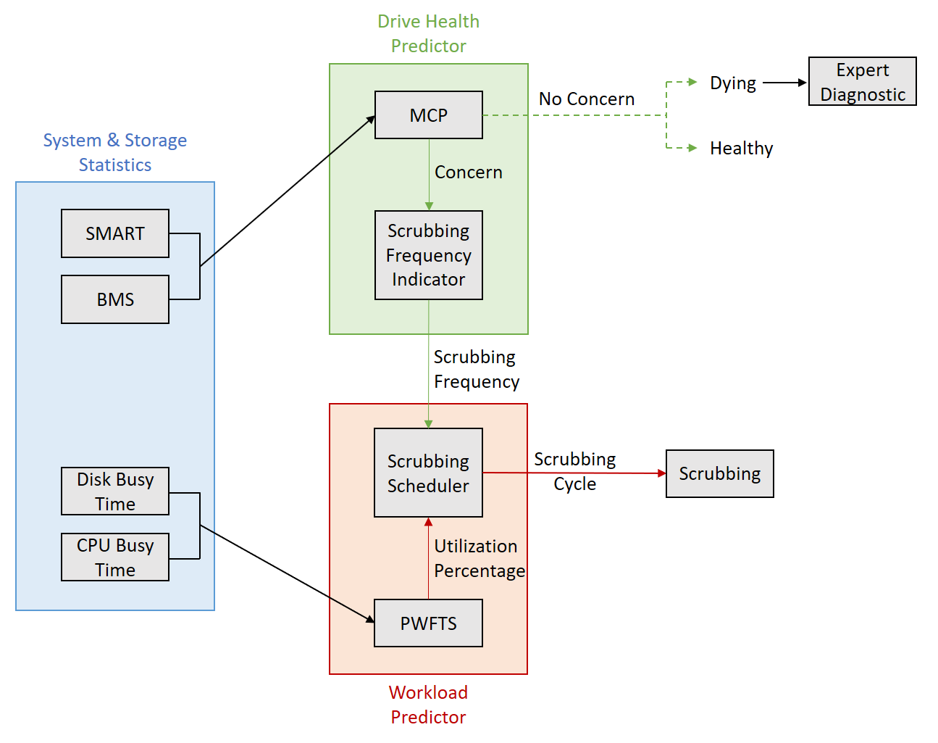
Introduction > Disk Scrubbing > Approach > Experiments > Conclusions and perspectives
Solution Architecture
Solution approach of Mondrian conformal disk drive scrubbing
Notes:
• SMART: stands for Self-Monitoring, Analysis, and Reporting Technology
• BMS: stands for Background Media Scanning
To maintain a balance between resource consumption (cpu usage for scrubbing) and scrubbing impact on disk health (because of scrubbing), we need to find a way to figure out when and which disk to scrub.
This will help reduce too frequent scrubbing and also save resources.

Slide 9
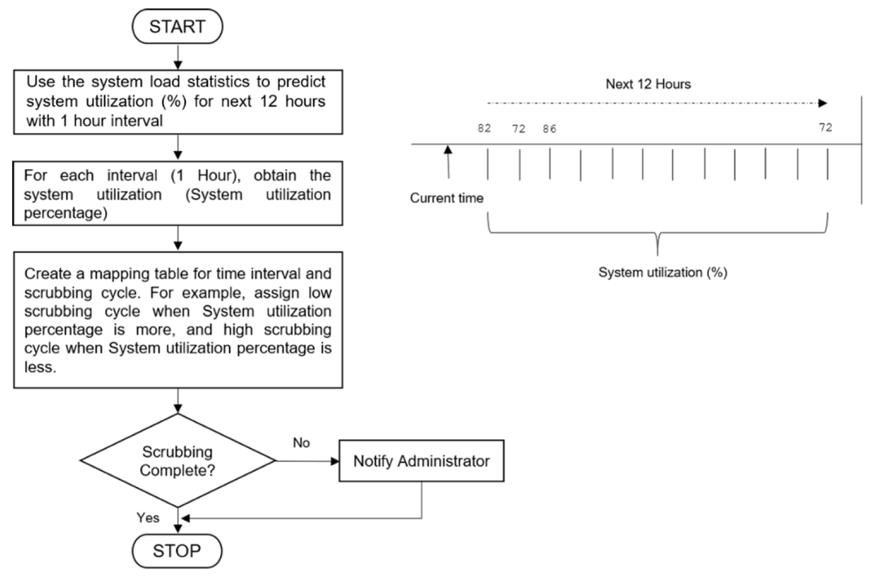
Introduction > Disk Scrubbing > Approach > Experiments > Conclusions and perspectives
When to scrub : Workload Predictor
Flowchart of the workload predictor using the PWFTS algorithm
Notes:
Probabilistically Weighted Fuzzy Time Series algorithm (PWFTS)

Slide 10
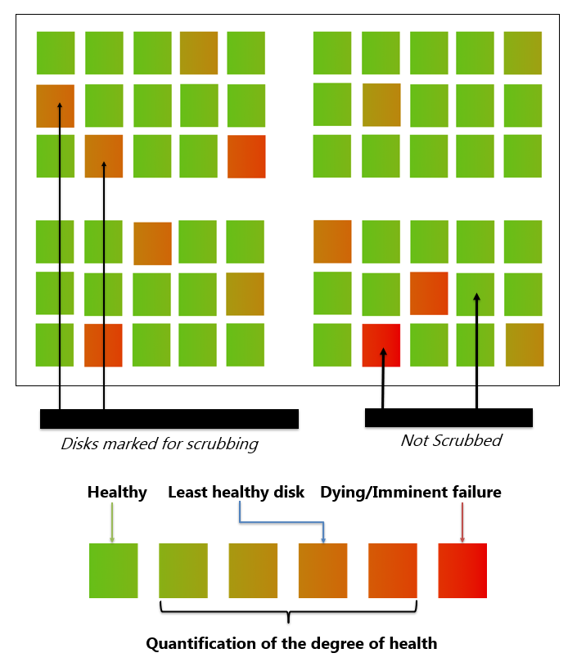
Introduction > Disk Scrubbing > Approach > Experiments > Conclusions and perspectives
Which disk to scrub : Drive Health Predictor
Selective scrubbing
Eliminate “no concern” disks (healthy / dying).
Identify the concerned disks.
Degree of health
Good, medium or poor.
Scrubbing cycle
Low, medium, high (respectively).
Mondrian Conformal Prediction

Slide 11
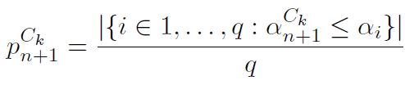



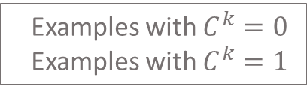







Introduction > Disk Scrubbing > Approach > Experiments > Conclusions and perspectives
Mondrian Conformal Prediction
« Traditional » Inductive Conformal Prediction :
Mondrian Conformal Prediction :
Examples with $C^{k}=0$
Examples with $C^{k}=1$
$$α_{n+1}^{0}$$
$$α_{n+1}^{1}$$
$$Z^{cal}$$
$$α_{n+1}^{0}$$
$$C^{k}=0$$
$$Z^{cal}$$
$$α_{n+1}^{1}$$
$$C^{k}=1$$
$$Z^{cal}$$

Slide 12

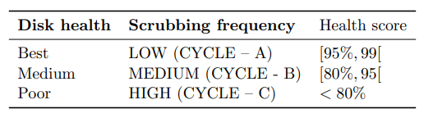
Introduction > Disk Scrubbing > Approach > Experiments > Conclusions and perspectives
Mondrian Conformal Prediction
Why ?
In most cases, drive health prediction is highly imbalanced.
We want to maintain the same error rate for both classes.
How ?
Binary classification : concern / no concern.
Confidence score as a health score, which then is turned into a scrubbing frequency.
Mapping of the disk health with the scrubbing frequency based on health score.

Slide 13
Experiments

Slide 14
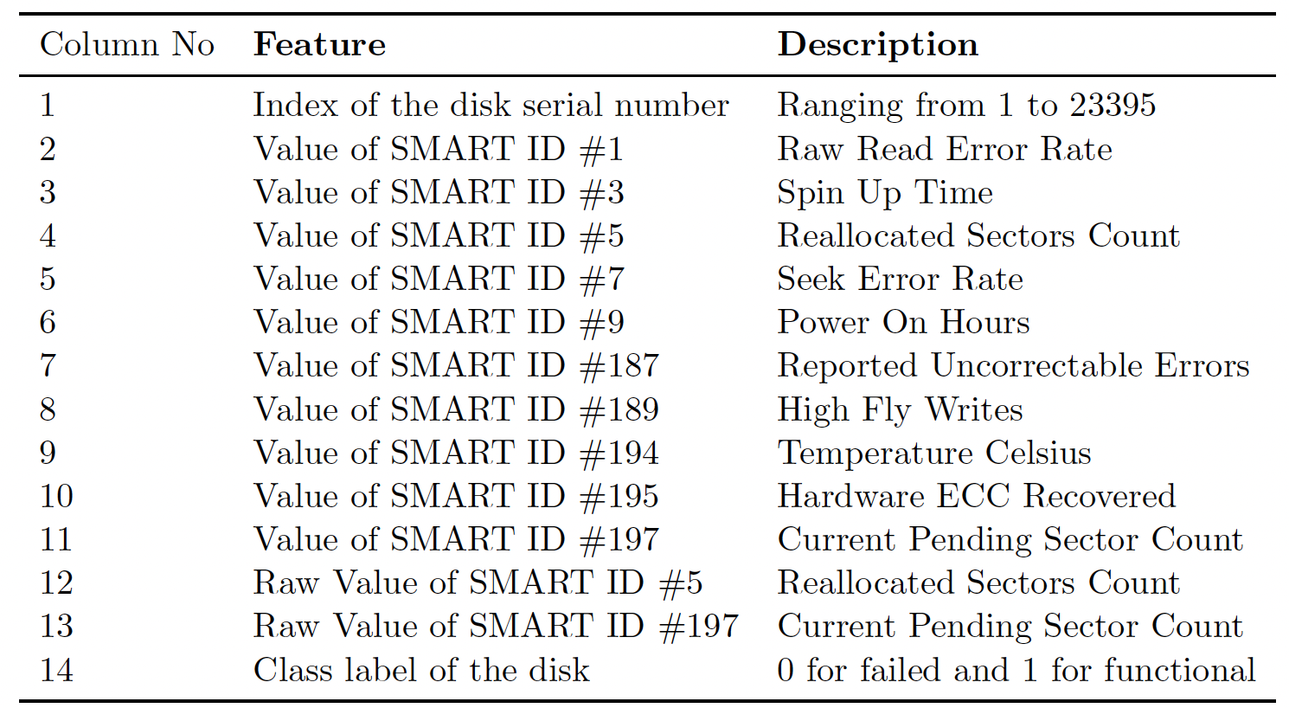
Introduction > Disk Scrubbing > Approach > Experiments > Conclusions and perspectives
Open-source Baidu dataset
Seagate ST31000524NS✻ (HDD) : 23395 units and 13 SMART attributes.
Features’ description for the Open-source Baidu dataset.
✻ Hdds dataset (baidu inc..), Jan 2023. https://www.kaggle.com/ datasets/drtycoon/hdds-dataset-baidu-inc.

Slide 15
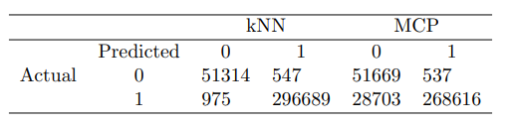

Introduction > Disk Scrubbing > Approach > Experiments > Conclusions and perspectives
Results
MCP identifies more disks of the minority class, but with a decrease in the number of disks correctly classified as healthy…
But this can be solved by considering the health score.
Comparison of confusion matrix results for disk drive classification using kNN and MCP.
The number of relatively healthy drives based on the health score intervals.
Only 22.7% of the number of disks is scrubbed.

Slide 16
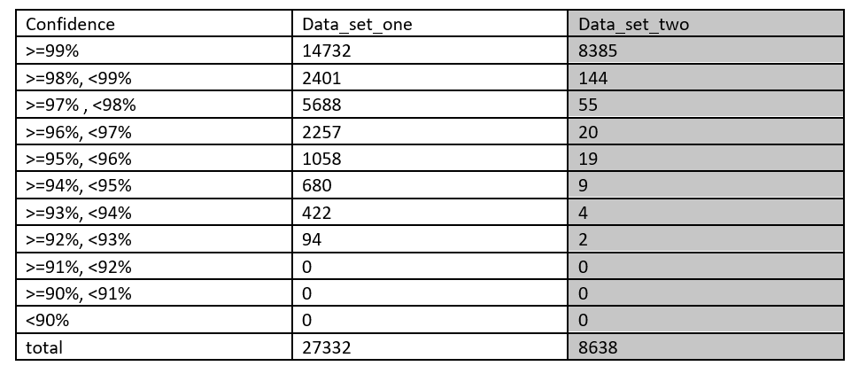
Introduction > Disk Scrubbing > Approach > Experiments > Conclusions and perspectives
Real life datasets
Data 1: 2015-01-01——2019-07-01, Hitachi drives
Data 2: 2015-01-01——2019-07-01, 3T ST330006CLAR3000
Comparison of confusion matrix results for disk drive classification using kNN and MCP.
Experiments on real life data centers.
Only 12600 (data 1) and 253 (data 2) disks are scrubbed, with different frequencies of scrubbing.

Slide 17
Conclusions and perspectives

Slide 18
Introduction > Disk Scrubbing > Approach > Experiments > Conclusions and perspectives
Conclusions
New Scrubbing Approach
Introduces a fine-grained method for selecting drives to be scrubbed.
Enhances the existing failure analysis engine with an algorithm-agnostic Mondrian conformal predictor.
Confidence-Based Health Ranking
Translates prediction confidence into a disk health ranking mechanism.
Transforms this ranking into a scrubbing frequency depending on the user’s preferences.
Optimized Scrubbing Schedule
Uses n-step ahead system load prediction.
Optimizes disk scrubbing for improved efficiency.
Energy saving and reduced carbon footprint for data centers

Slide 19
Introduction > Disk Scrubbing > Approach > Experiments > Conclusions and perspectives
Perspectives
Improve the current approach by exploring other non-conformity measures.
Apply the approach in large-scale data centers, preferably in real-life cases.
Consider Venn-Abers predictors with calibrated probabilities for predictions.

Slide 20
Thank you for your attention

